Slide 1
Udacity- Intel

Slide 2
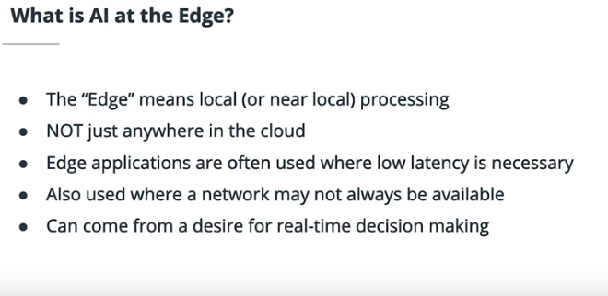
What is AI at the Edge?

Slide 3
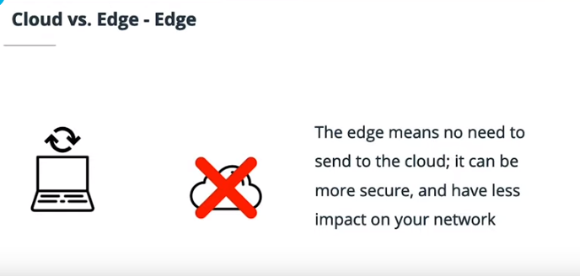
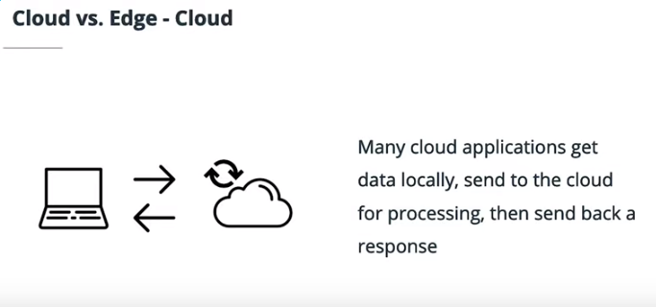
Edge vs. Cloud

Slide 4
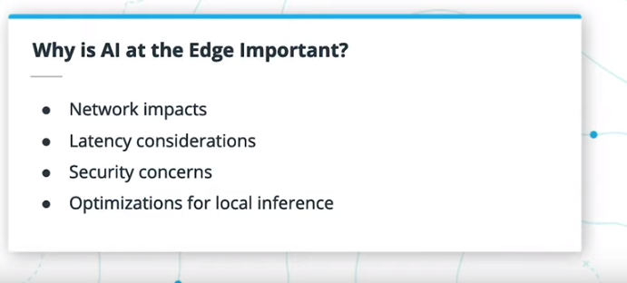

Slide 5
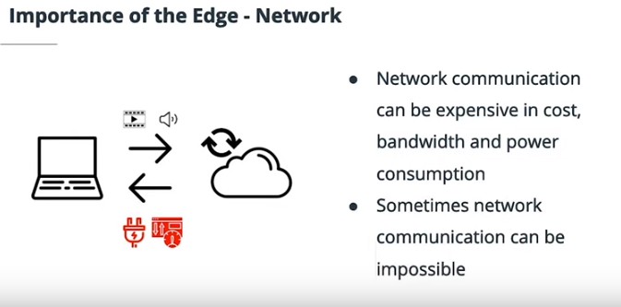
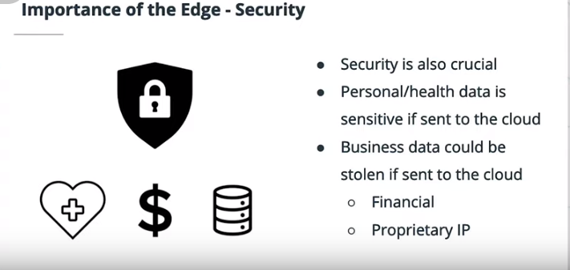
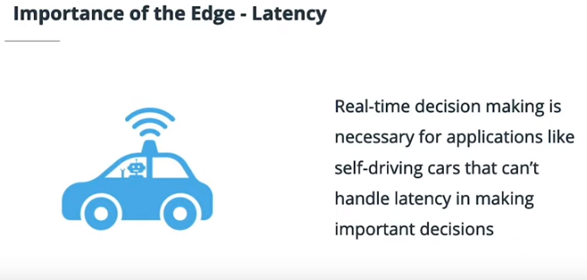
Importance of the Edge

Slide 6
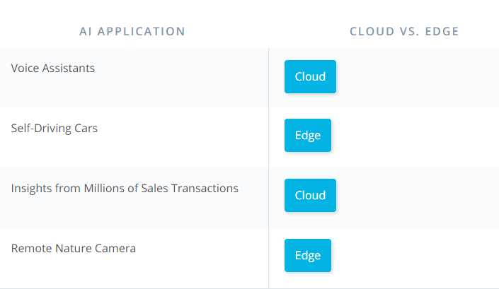
Quizz

Slide 7
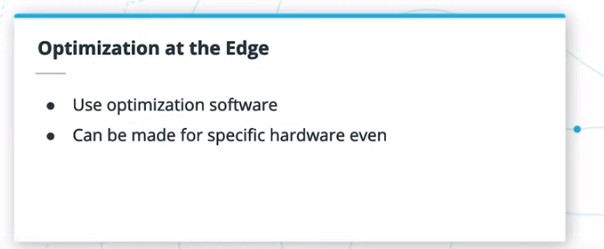

Slide 8
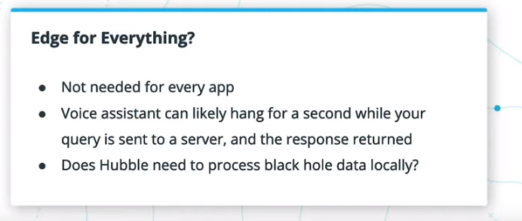
Edge Applications

Slide 9
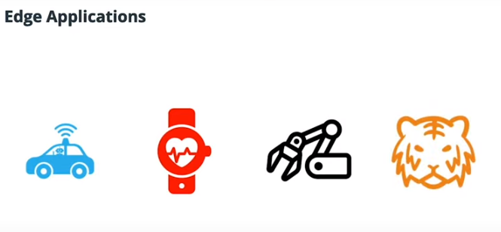
Edge Applications

Slide 10
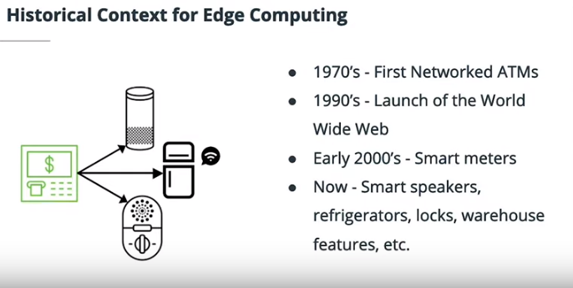
Historical Context

Slide 11
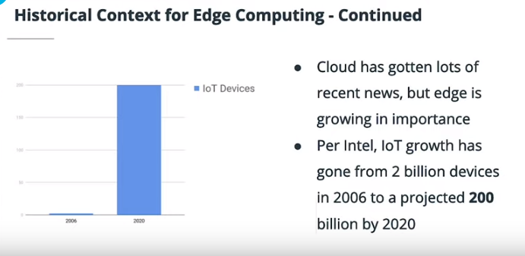

Slide 12
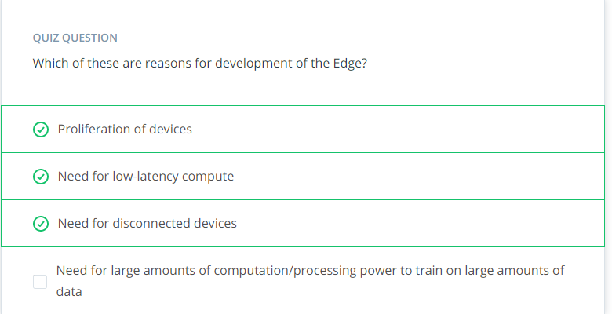

Slide 13
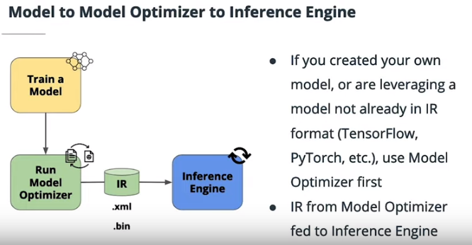
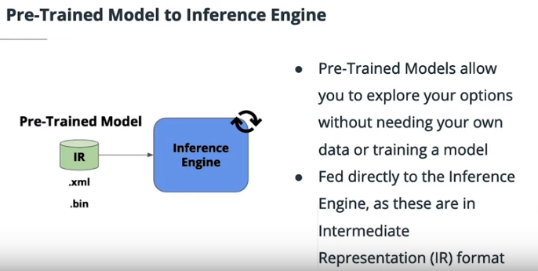
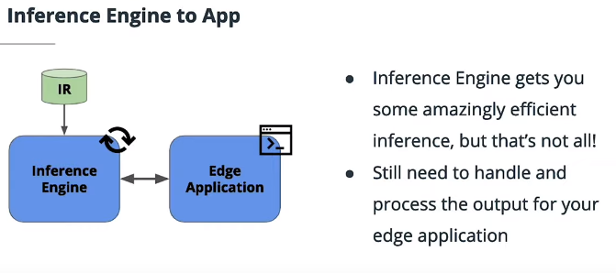

Slide 14
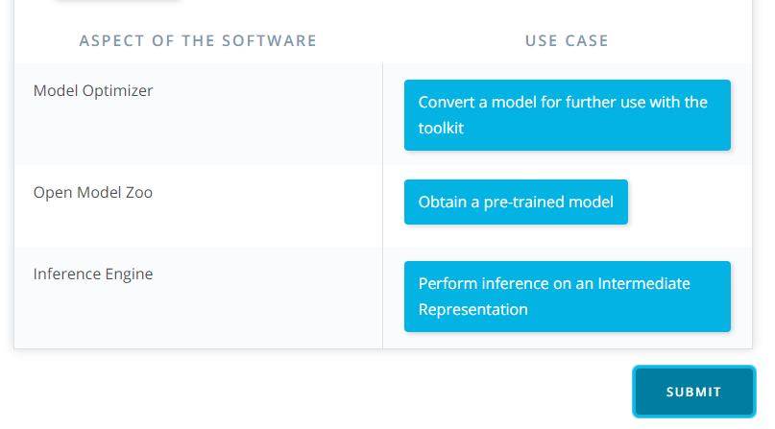
Use Cases

Slide 15
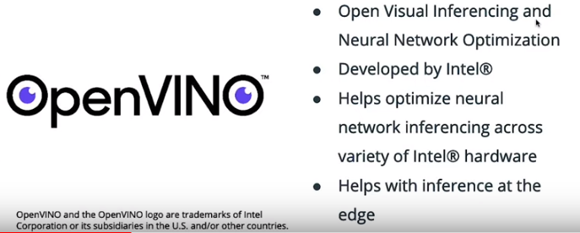
Lesson 2 – Leveraging Pre-trained Models
The Intel Distribution of OpenVINO Toolkit : Open Visual Inferencing and Neural Network Optimization

Slide 16
Edge Role

Slide 17
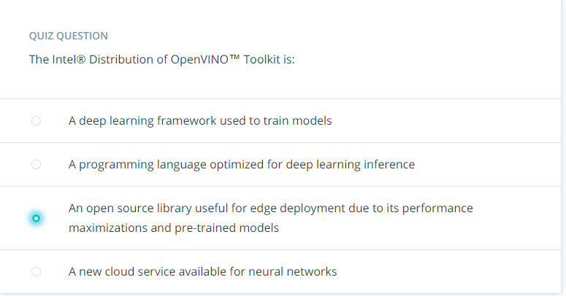
Quizz

Slide 18
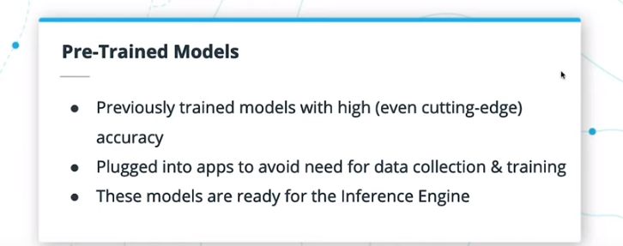
What are Pre-trained Models

Slide 19
Computer Vision Models
Classification
Detection
Segmentation

Slide 20
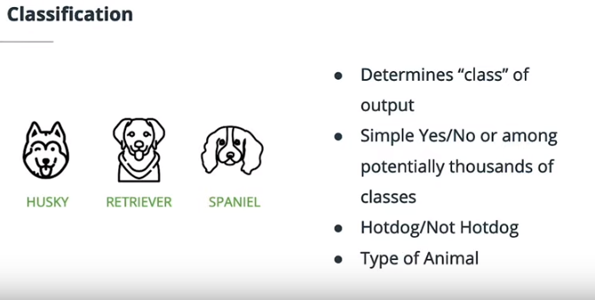
Classification

Slide 21
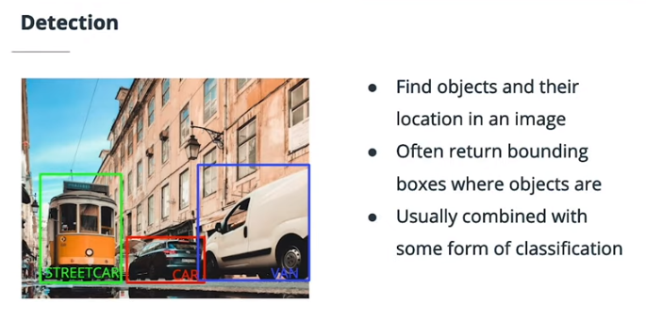
Detection

Slide 22
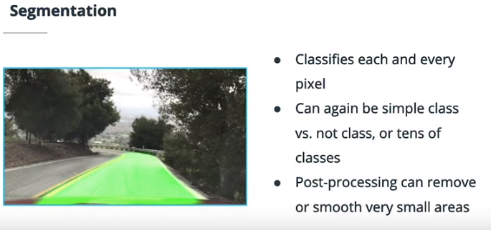
Segmentation

Slide 23
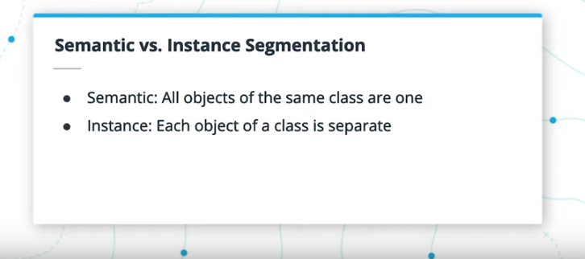
Segmentation

Slide 24
Case Studies in Computer Vision
SSD is an object detection network that combined classification with object detection through the use of default bounding boxes at different network levels.
ResNet utilized residual layers to “skip” over sections of layers, helping to avoid the vanishing gradient problem with very deep neural networks.
MobileNet utilized layers like 1x1 convolutions to help cut down on computational complexity and network size, leading to fast inference without substantial decrease in accuracy.

Slide 25
Case Studies in Computer Vision
One additional note here on the ResNet architecture - the paper itself actually theorizes that very deep neural networks have convergence issues due to exponentially lower convergence rates, as opposed to just the vanishing gradient problem.
The vanishing gradient problem is also thought to be helped by the use of normalization of inputs to each different layer, which is not specific to ResNet.
The ResNet architecture itself, at multiple different numbers of layers, was shown to converge faster during training than a “plain” network without the residual layers.

Slide 26
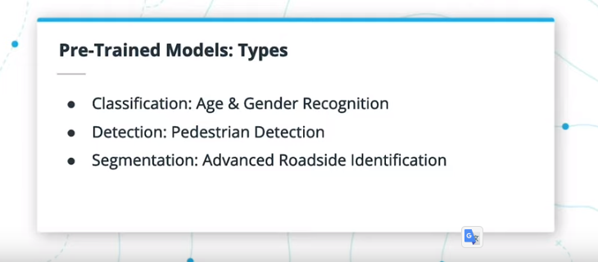
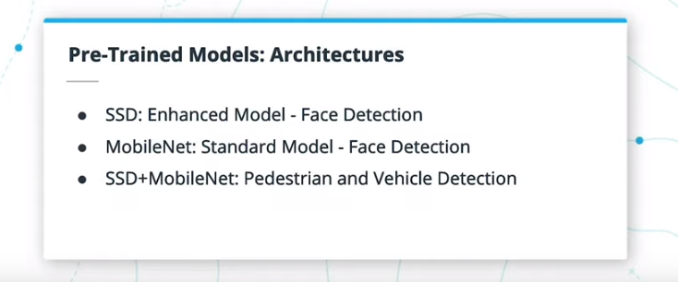
Available Pre-Trained Models in OpenVINO
Most of the Pre-Trained Models supplied by OpenVINO™ fall into either face detection, human detection, or vehicle-related detection.

Slide 27
Choosing the right Model of your app
This goes both ways - you should try out different models for a single use case, but you should also consider how a given model can be applied to multiple use cases.
For example, being able to track human poses could help in physical therapy applications to assess and track progress of limb movement range over the course of treatment.

Slide 28
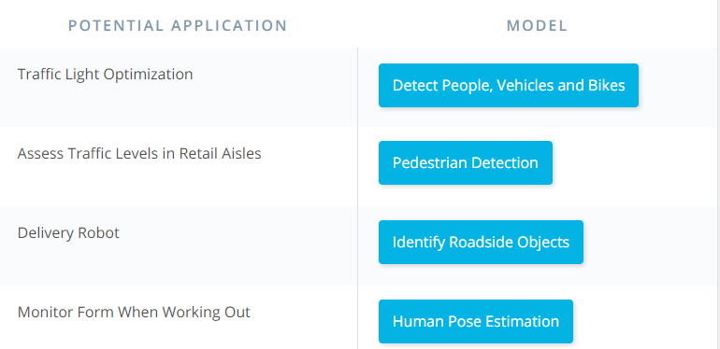

Slide 29
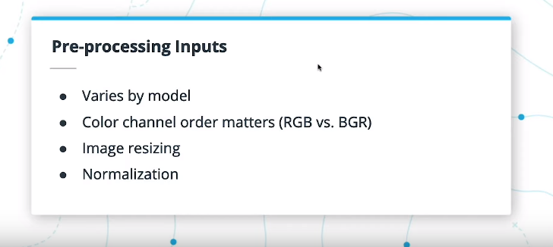
Pre- Processing Inputs
The pre-processing needed for a network will vary .It can even matter what library you use to load an image or frame.
Outside of channel order, you also need to consider image size, and the order of the image data, such as whether the color channels come first or last in the dimensions. Certain models may require a certain normalization of the images for input, such as pixel values between 0 and 1, although some networks also do this as their first layer.

Slide 30
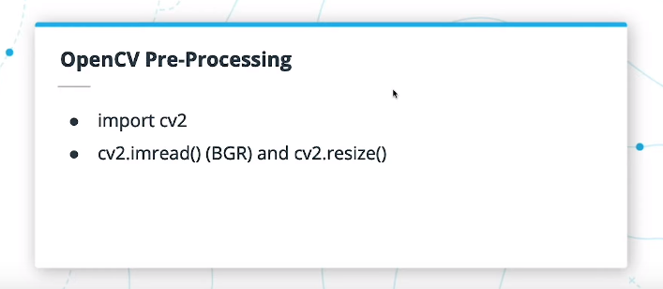
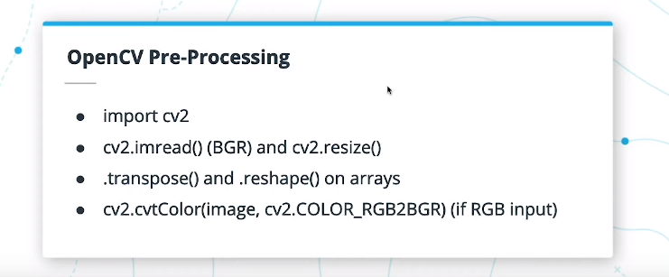
Pre- Processing Inputs
In OpenCV, you can use cv2.imread to read in images in BGR format, and cv2.resize to resize them. The images will be similar to a numpy array, so you can also use array functions like .transpose and .reshape on them as well, which are useful for switching the array dimension order.

Slide 31
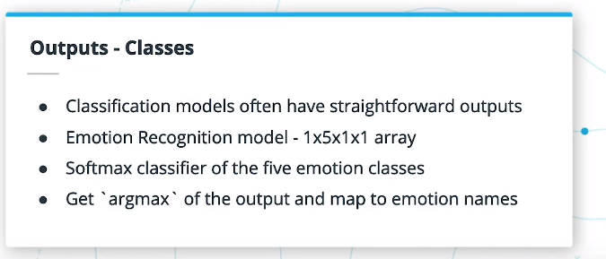
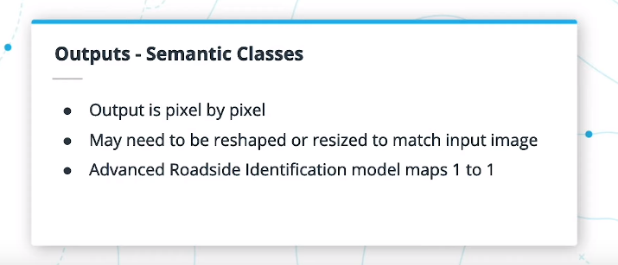
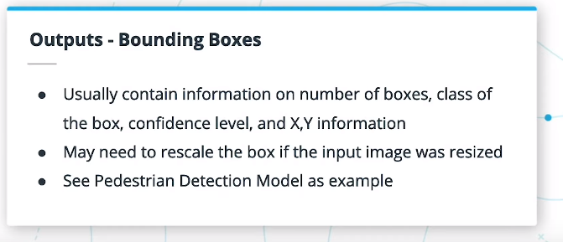
Handling Network Outputs

Slide 32
Lesson Glossary
Edge Application
Applications with inference run on local hardware, sometimes without network connections, such as Internet of Things (IoT) devices, as opposed to the cloud. Less data needs to be streamed over a network connection, and real-time decisions can be made.
OpenVINO™ Toolkit
The Intel® Distribution of OpenVINO™ Toolkit enables deep learning inference at the edge by including both neural network optimizations for inference as well as hardware-based optimizations for Intel® hardware.

Slide 33
Lesson Glossary
Pre-Trained Model
Computer Vision and/or AI models that are already trained on large datasets and available for use in your own applications. These models are often trained on datasets like ImageNet. Pre-trained models can either be used as is or used in transfer learning to further fine-tune a model. The OpenVINO™ Toolkit provides a number of pre-trained models that are already optimized for inference.
Transfer Learning
The use of a pre-trained model as a basis for further training of a neural network. Using a pre-trained model can help speed up training as the early layers of the network have feature extractors that work in a wide variety of applications, and often only late layers will need further fine-tuning for your own dataset. OpenVINO™ does not deal with transfer learning, as all training should occur prior to using the Model Optimizer.

Slide 34
Lesson Glossary
Image Classification
A form of inference in which an object in an image is determined to be of a particular class, such as a cat vs. a dog.
Object Detection
A form of inference in which objects within an image are detected, and a bounding box is output based on where in the image the object was detected. Usually, this is combined with some form of classification to also output which class the detected object belongs to.
Semantic Segmentation
A form of inference in which objects within an image are detected and classified on a pixel-by-pixel basis, with all objects of a given class given the same label.
Instance Segmentation
Similar to semantic segmentation, this form of inference is done on a pixel-by-pixel basis, but different objects of the same class are separately identified.

Slide 35
Lesson Glossary
SSD
A neural network combining object detection and classification, with different feature extraction layers directly feeding to the detection layer, using default bounding box sizes and shapes.
YOLO
One of the original neural networks to only take a single look at an input image, whereas earlier networks ran a classifier multiple times across a single image at different locations and scales.
Faster R-CNN
A network, expanding on R-CNN and Fast R-CNN, that integrates advances made in the earlier models by adding a Region Proposal Network on top of the Fast R-CNN model for an integrated object detection model.
MobileNet
A neural network architecture optimized for speed and size with minimal loss of inference accuracy through the use of techniques like 1x1 convolutions. As such, MobileNet is more useful in mobile applications that substantially larger and slower networks.

Slide 36
Lesson Glossary
ResNet
A very deep neural network that made use of residual, or “skip” layers that pass information forward by a couple of layers. This helped deal with the vanishing gradient problem experienced by deeper neural networks.
Inception
A neural network making use of multiple different convolutions at each “layer” of the network, such as 1x1, 3x3 and 5x5 convolutions. The top architecture from the original paper is also known as GoogLeNet, an homage to LeNet, an early neural network used for character recognition.
Inference Precision
Precision refers to the level of detail to weights and biases in a neural network, whether in floating point precision or integer precision. Lower precision leads to lower accuracy, but with a positive trade-off for network speed and size.

Slide 37
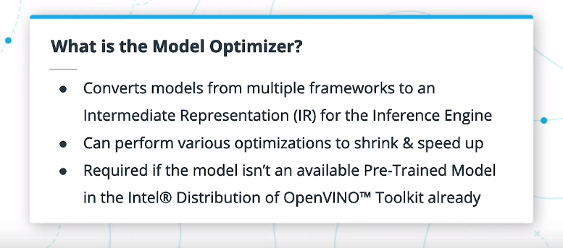
Lesson 3 – The Model Optimizer

Slide 38
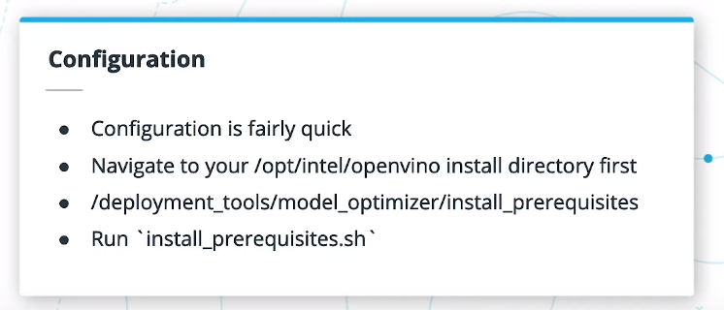
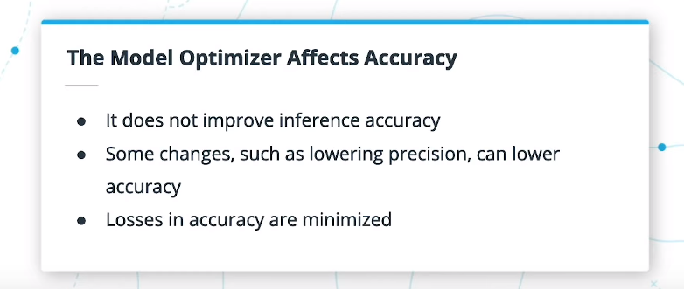
The Model Optimizer

Slide 39
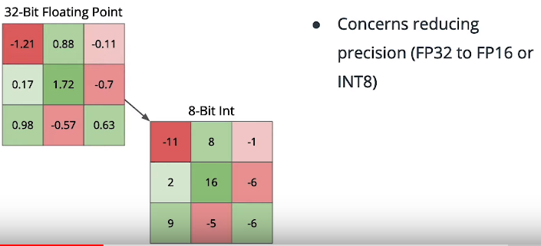
Optimization Techniques - Quantization
How many bits are used to represent the weights and biases of the model.
During training, having these very accurate numbers can be helpful, but it’s often the case in inference that the precision can be reduced without substantial loss of accuracy.
Quantization is the process of reducing the precision of a model.
With the OpenVINO™ Toolkit, models usually default to FP32, or 32-bit floating point values, while FP16 and INT8, for 16-bit floating point and 8-bit integer values, are also available (INT8 is only currently available in the Pre-Trained Models; the Model Optimizer does not currently support that level of precision).
FP16 and INT8 will lose some accuracy, but the model will be smaller in memory and compute times faster.
Therefore, quantization is a common method used for running models at the edge.

Slide 40
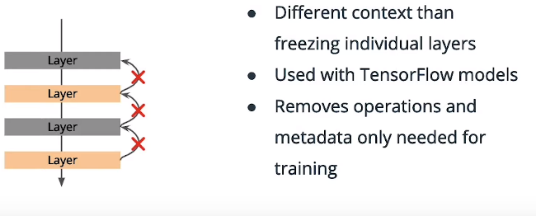
Optimization Techniques - Freezing

Slide 41
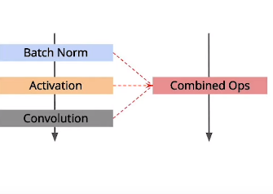
Optimization Techniques - Fusion
Fusion relates to combining multiple layer operations into a single operation.
For example, a batch normalization layer, activation layer, and convolutional layer could be combined into a single operation.
This can be particularly useful for GPU inference, where the separate operations may occur on separate GPU kernels, while a fused operation occurs on one kernel, thereby incurring less overhead in switching from one kernel to the next.

Slide 42
Supported Frameworks
Caffe
Tensorflow
MXNet
ONNX (including Pytorch and Apple ML)
Kaldi

Slide 43
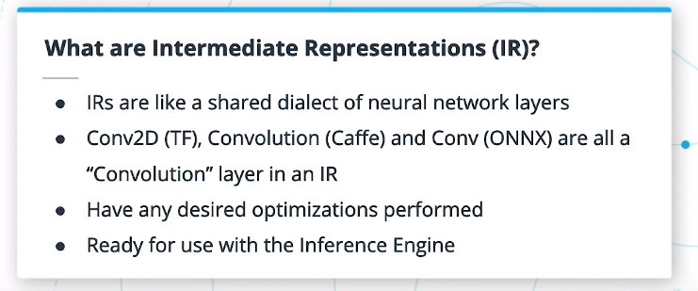
What are Intermediate Representations (IR)
IRs are like a shared dialect of neural network layers

Slide 44
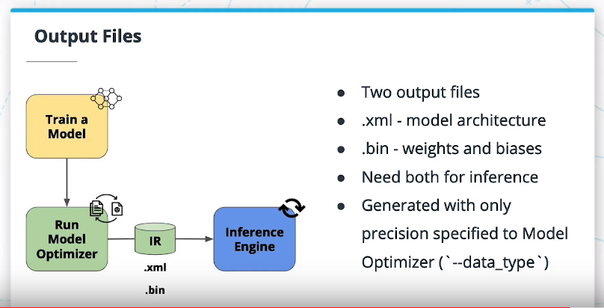
The Intermediate Representation Is a model where specific layers of supported deep learning frameworks are replaced with layers in the “dialect” of the Inference Engine.

Slide 45
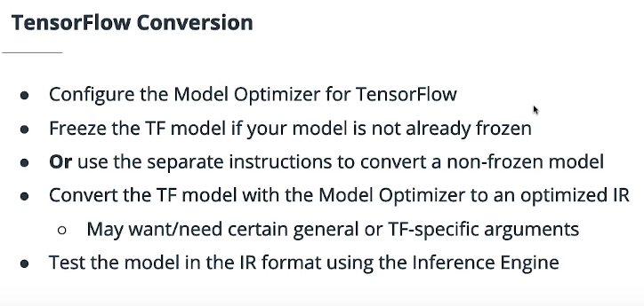
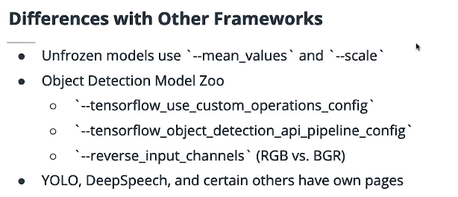
Using the Model Optimizer with Tensorflow Models

Slide 46
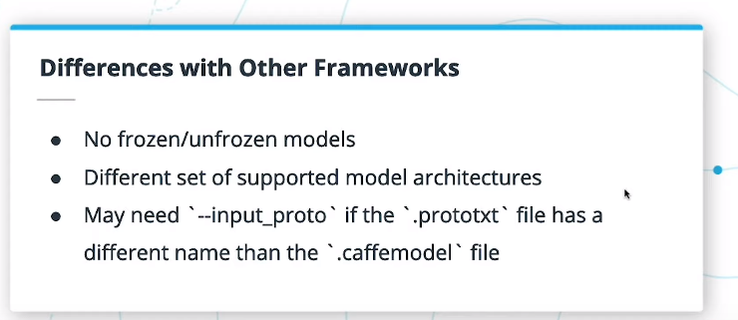
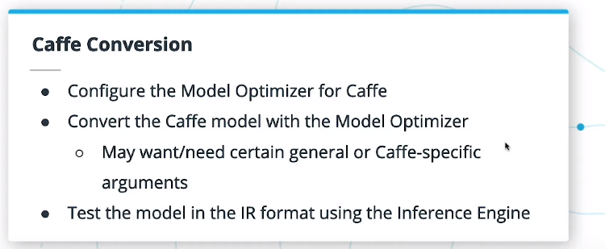
Using the Model Optimizer with caffe Models

Slide 47
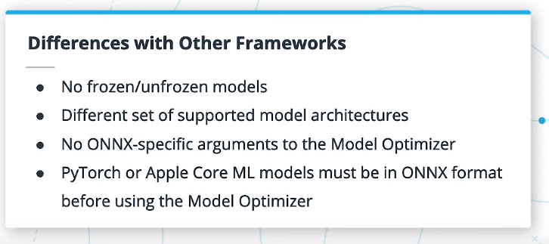
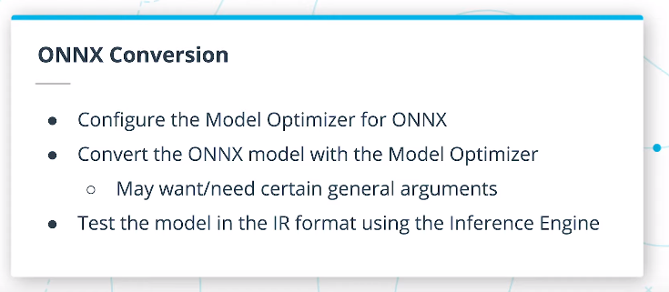
Using the Model Optimizer with ONNX Models

Slide 48
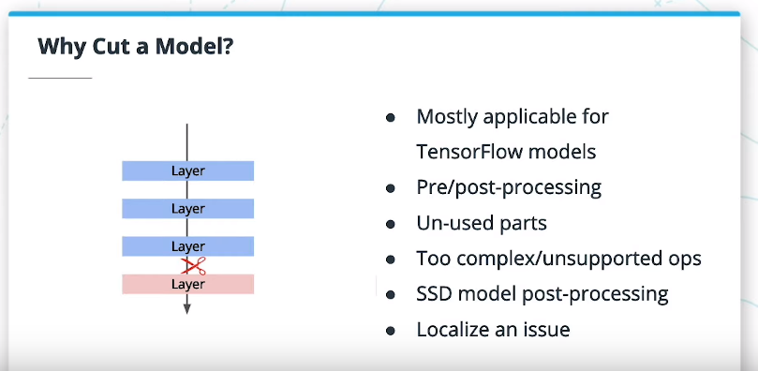
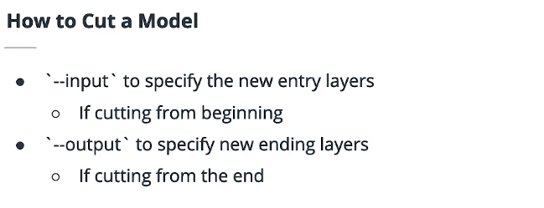
Cutting Parts of a Model

Slide 49


Supported Layers
Supported layers are layers directly supported in the openvino toolkit.
Custom layers are one way to still handle the layers not among the built-in supported layers.
What happens when a layer isn’t supported by the Model Optimizer? One potential solution is the use of custom layers.
Another solution is actually running the given unsupported layer in its original framework.
For example, you could potentially use TensorFlow to load and process the inputs and outputs for a specific layer you built in that framework, if it isn’t supported with the Model Optimizer.

Slide 50


Custom Layers

Slide 51
Lesson Glossary
Intermediate Representation
A set of files converted from one of the supported frameworks, or available as one of the Pre-Trained Models. This has been optimized for inference through the Inference Engine, and may be at one of several different precision levels. Made of two files:
.xml - Describes the network topology
.bin - Contains the weights and biases in a binary file
Supported Layers
Layers supported for direct conversion from supported framework layers to intermediate representation layers through the Model Optimizer. While nearly every layer you will ever use is in the supported frameworks is supported, there is sometimes a need for handling Custom Layers.
Custom Layers
Custom layers are those outside of the list of known, supported layers, and are typically a rare exception. Handling custom layers in a neural network for use with the Model Optimizer depends somewhat on the framework used; other than adding the custom layer as an extension, you otherwise have to follow instructions specific to the framework.

Slide 52


Lesson 4 – The Inference Engine

Slide 53


The Inference Engine
FPGAs, or Field Programmable Gate Arrays, are able to be further configured by a customer after manufacturing. Hence the “field programmable” part of the name.
VPUs, or Vision Processing Units, are going to be like the Intel® Neural Compute Stick. They are small, but powerful devices that can be plugged into other hardware, for the specific purpose of accelerating computer vision tasks.

Slide 54


Using the Inference Engine with an IR (Intermediate Representation)

Slide 55


Using the Inference Engine with an IR
What happens if a layers wasn’t supported?.. Adding CPU Extensions

Slide 56

Sending Inference Requests to the IE

Slide 57



Asynchronous vs Synchronous Requests

Slide 58


Handling Results

Slide 59

Integrating into your app

Slide 60



Behind the Scenes of Inference Engine

Slide 61
Lesson Glossary
Inference Engine
Provides a library of computer vision functions, supports calls to other computer vision libraries such as OpenCV, and performs optimized inference on Intermediate Representation models. Works with various plugins specific to different hardware to support even further optimizations.
Synchronous
Such requests wait for a given request to be fulfilled prior to continuing on to the next request.
Asynchronous
Such requests can happen simultaneously, so that the start of the next request does not need to wait on the completion of the previous.

Slide 62
Lesson Glossary
IECore
The main Python wrapper for working with the Inference Engine. Also used to load an IENetwork, check the supported layers of a given network, as well as add any necessary CPU extensions.
IENetwork
A class to hold a model loaded from an Intermediate Representation (IR). This can then be loaded into an IECore and returned as an Executable Network.
ExecutableNetwork
An instance of a network loaded into an IECore and ready for inference. It is capable of both synchronous and asynchronous requests, and holds a tuple of InferRequest objects.
InferRequest
Individual inference requests, such as image by image, to the Inference Engine. Each of these contain their inputs as well as the outputs of the inference request once complete.

Slide 63



Lesson 5 – Deploying an Edge App

Slide 64


Handling Input Streams

Slide 65


Gathering Useful Information from Model Outputs

Slide 66

Intro to MQTT
MQTT stands for MQ Telemetry Transport, where the MQ came from an old IBM product line called IBM MQ for Message Queues (although MQTT itself does not use queues). That doesn’t really give many hints about its use.
MQTT is a lightweight publish/subscribe architecture that is designed for resource-constrained devices and low-bandwidth setups. It is used a lot for Internet of Things devices, or other machine-to-machine communication, and has been around since 1999. Port 1883 is reserved for use with MQTT

Slide 67


Communicating with MQTT

Slide 68



Streaming Images to a Server

Slide 69


Handling Statistics and Images from a Node Server

Slide 70




Analyzing Performance Basics

Slide 71


Model Use Cases

Slide 72

Concerning End User Needs

Slide 73
Lesson Glossary
OpenCV
A computer vision (CV) library filled with many different computer vision functions and other useful image and video processing and handling capabilities.
MQTT
A publisher-subscriber protocol often used for IoT devices due to its lightweight nature. The paho-mqtt library is a common way of working with MQTT in Python.
Publish-Subscribe Architecture
A messaging architecture whereby it is made up of publishers, that send messages to some central broker, without knowing of the subscribers themselves. These messages can be posted on some given “topic”, which the subscribers can then listen to without having to know the publisher itself, just the “topic”.
Node Server
A web server built with Node.js that can handle HTTP requests and/or serve up a webpage for viewing in a browser.

Slide 74
Lesson Glossary
Publisher
In a publish-subscribe architecture, the entity that is sending data to a broker on a certain “topic”.
Subscriber
In a publish-subscribe architecture, the entity that is listening to data on a certain “topic” from a broker.
Topic
In a publish-subscribe architecture, data is published to a given topic, and subscribers to that topic can then receive that data.
FFmpeg
Software that can help convert or stream audio and video. In the course, the related ffserver software is used to stream to a web server, which can then be queried by a Node server for viewing in a web browser.
Flask
A Python framework useful for web development and another potential option for video streaming to a web browser.

